Slide 1
Redeem Coupon Prediction
Shubham Raut

Slide 2
Problem Statement
Predict whether customers redeem the coupons received across channels, which will enable the retailer’s marketing team to accurately design coupon construct, and develop more precise and targeted marketing strategies.

Slide 3
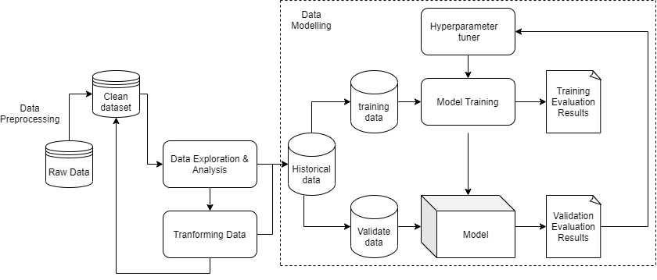
Solution Flow

Slide 4
Data Understanding
Train_data : -
Contain the coupons offered to the given customer under the 18 campaigns.
Only 0.93% of coupons offered are redeemed.
Campaign_data :-
Contain Campaign information for each of the 28 campaigns
There are 22 0f Y type campaigns and 6 of X type campaigns
Coupon_Item_mapping :-
Contain mapping of coupon and item.
There are coupons that applied to multiple items

Slide 5
Data Understanding (continued)
Customer_Demographics :-
Contain customer information
Customer_transaction_data :-
Transaction data for all customers for duration of campaigns in the train data
There are only 1.6% of transactions that received coupon discount.
Item_data :-
Item information for each item sold by the retailer.

Slide 6
Data Cleaning
Missing data : -
no_of_children : Assuming it to be zero
Marital_status : Filled ‘na’ with an unknown
Age_range : Filled ‘na’ with an unknown
rented : Since the majority of values for rented is 0, we filled the missing values with 0.
family_size : Filled ‘na’ with an unknown
Outliers :-
Since data is highly imbalanced, removing outlier may leads to removal of important data points. So the prediction algorithm need to be trained with outliers.

Slide 7
Data Preparation
Customer transaction Data(cust_tran) :-
It is needed to aggregated to extract meaningful information as it does not have a primary key but has different types of ids that are used multiple times. ( customer_id, item_id)
We aggregated transaction data on each item and then merge it with items data which gives us the sales of each items.(item_tran)
Similar We can aggregate transaction data on each customer id and then merge it with customer data which gives us the customer buying habit.(customer_history)
Train data :-
Train data does not include information about items and customers, so here we can merge this data with item_tran and customer_history

Slide 8
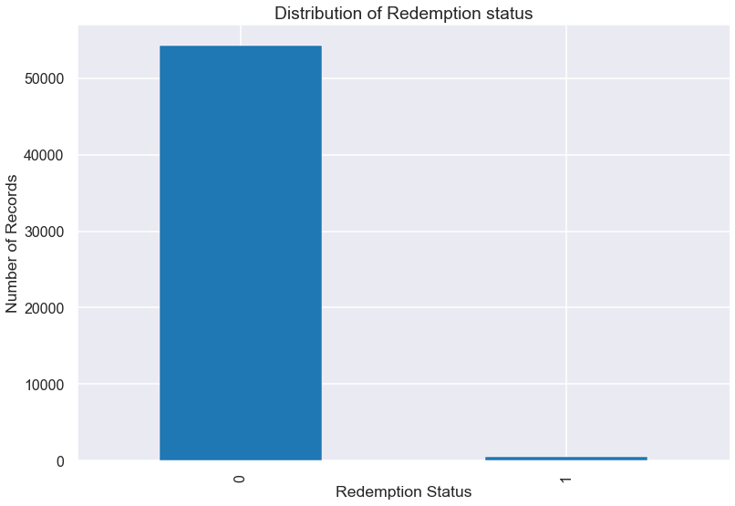
Exploratory data analysis
The Dataset is highly imbalanced. Only 0.94% of data is of redemption

Slide 9
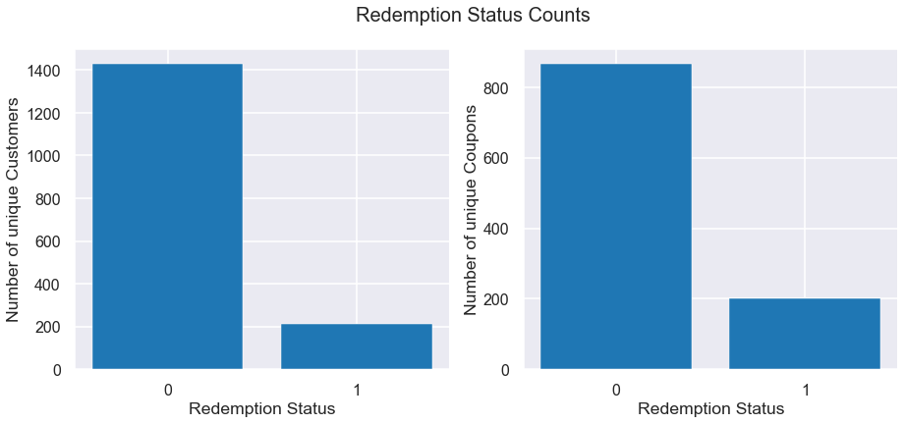
77% coupons were never redeemed by any customer
86% customers have never redeemed any coupons

Slide 10
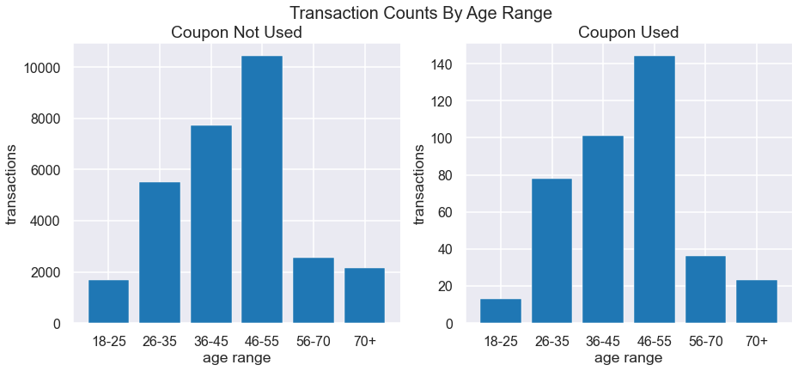
Can you provide customer insights (by demographics, income, personal life, lifestyle etc.) and their propensity to redeem a coupon
Even though age group 46-55 have made the most redemptions. The age group 26-35, 36-45, 56-70 have almost same redemption percentage with respect to number of transactions in each age group.

Slide 11
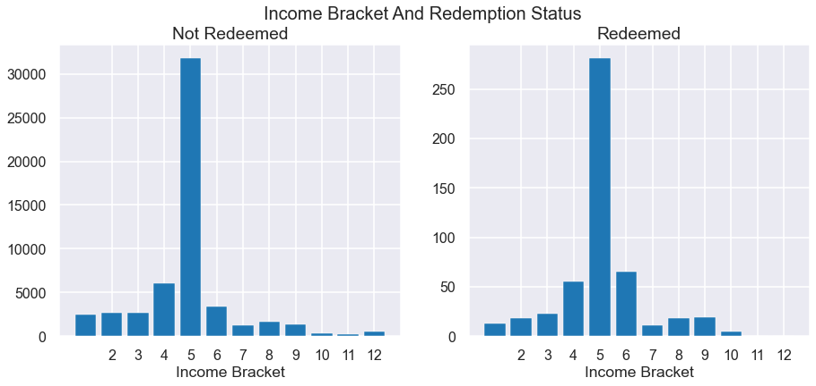
In term of count, the income bracket 5 as most number of redemption. But when compare the redemption percentage with respect to number of transactions in each income bracket, the income bracket 6 as more redemption.

Slide 12
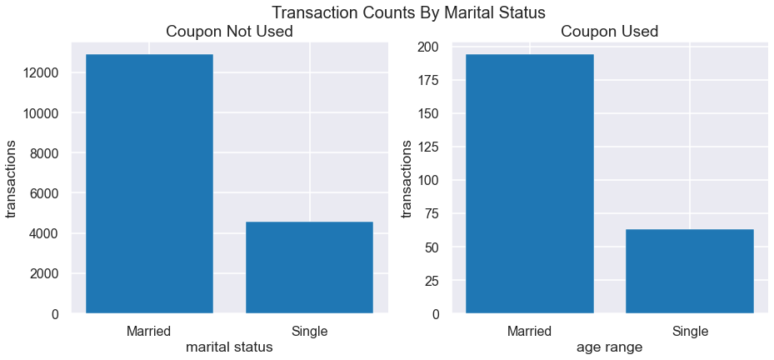

Slide 13
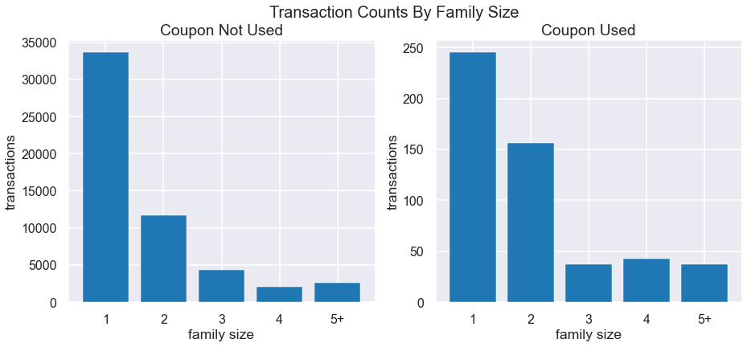
In term of count, the family size 1 as most number of redemption. But when compare to the redemption percentage with respect to number of transactions in each family size group, the family size 4 as more redemption.

Slide 14
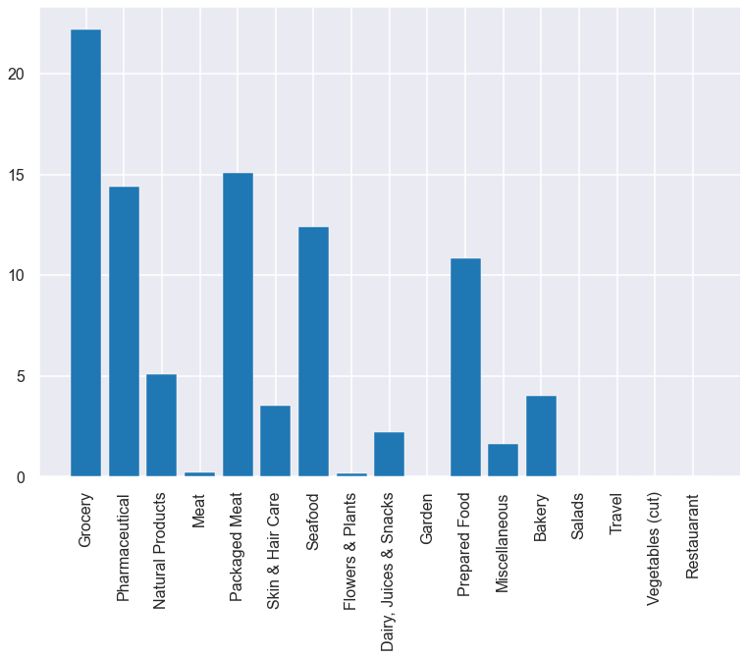
coupons should be used more by the organization in the upcoming days and which coupons the company should discard?
Coupons are applied to Garden, Salads, Travel, Vegetables, Restaurant are never redeemed. So this coupons can be discarded.
22% out of total coupon applied to grocery is redeemed. Similar 14% out of total coupons applied to the Pharmaceutical is redeemed. so the organization should focus on the coupon that applies to this category.

Slide 15
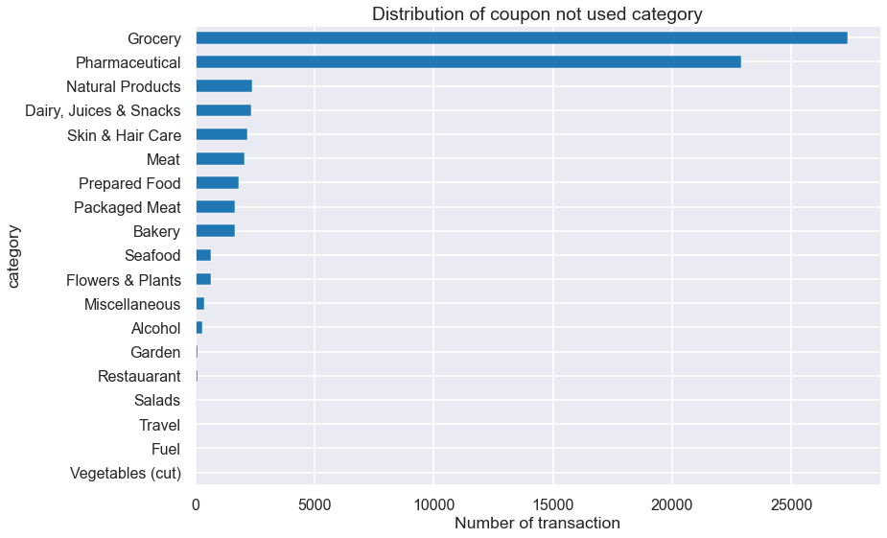
profile the products/items based on various characteristics like price, item category, propensity to be sold, discount percentage

Slide 16
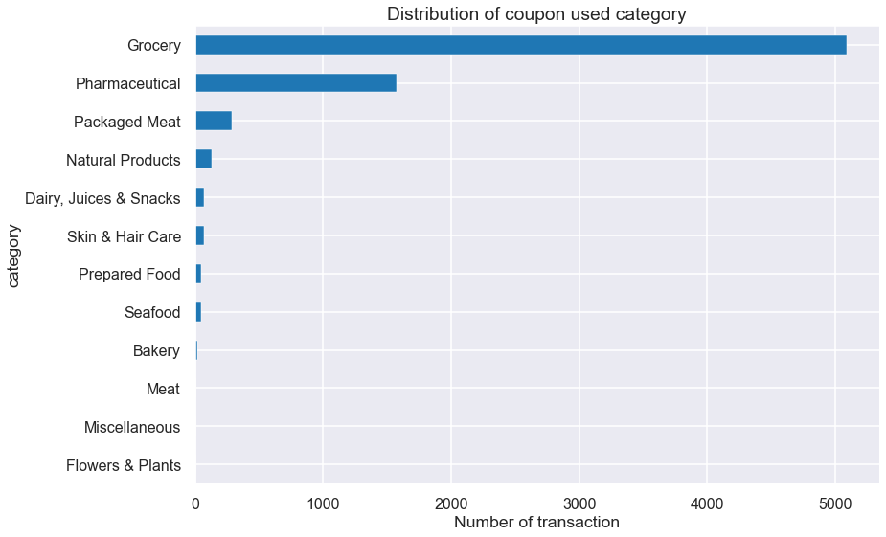

Slide 17
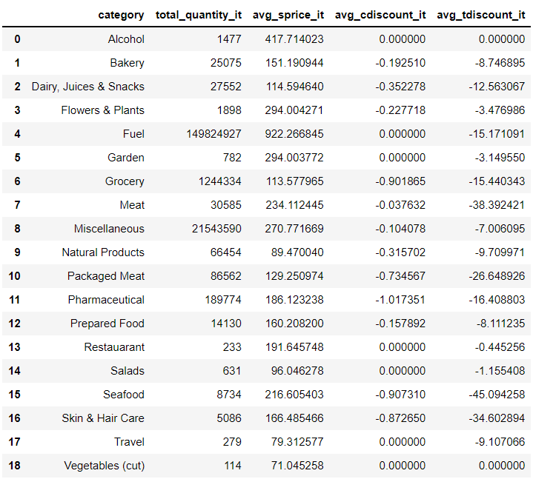
Fuels and Miscellaneous items are sold the most.
Items under category of Alcohol, Restaurant, Salads, Travel, Vegetable as zero coupon discount.

Slide 18
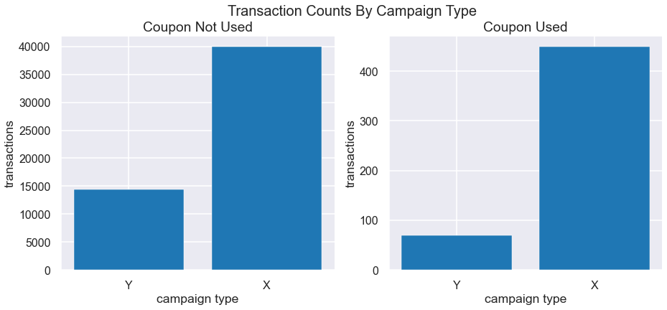
which campaigns are more profitable
The average transaction counts by campaign types: On average, the number of transactions is much higher during the X type campaigns. so we can say that X type campaign are more profitable

Slide 19
Modelling
The algorithm we used to build models are logistics regression, decision tree, random forest, gradient boosting.
This algorithm were chosen as their distinct ways for models to be trained and all provides features importances for analyzing results.
The models were tuned based on the recall scores as the most important thing for modeling for this project is to detect as much positive classes as possible.

Slide 20
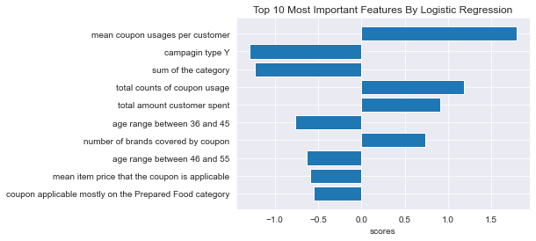
Importance Features

Slide 21
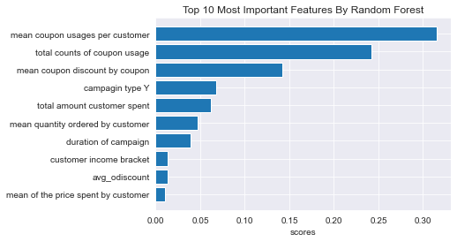

Slide 22
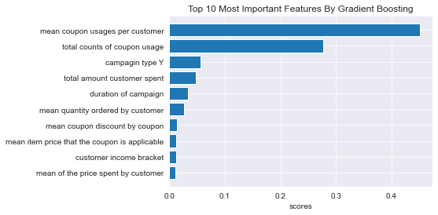

Slide 23
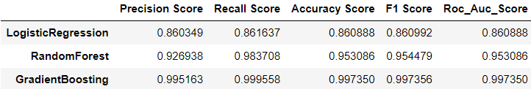
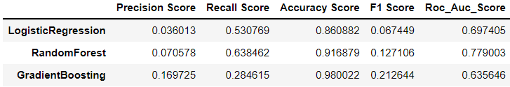
Result
Train Scores
Test Scores

Slide 24
Recommendation (on basis of slide 20)
From chart we say that Y type campaigns negatively impact which can be thought as customers would anticipate using more coupons during X type campaign and would pay less attention to the coupon for the type Y campaigns. By changing type Y promotion to type X promotion we can increase the redemption rate.
We can see that widely applicable coupons over different brands are more likely to be redeemed. so we make coupons that are less specific towards brands.
Customer who use many coupons are likely to use coupons more coupons so we can encourage this customers to use more coupons by improving source of promotion/coupon advertisement
Customers with a high spending level in entire transaction history i.e loyal customer or big spenders are more likely to use coupon

Slide 25
Thank You

